Slide 1


Distributed Systems with Cats-Effect and ETCD
Jamie Wickham-Jones
18th October 2023
Quantexa®

Slide 2

Intro
Myself – Team Lead at Quantexa. Web Dev before
Aim for tonight: build a Distributed Work-Sharing system that is scalable and resilient
Github link at bottom of every slide
github.com/anjuna/etcd-cats-talk
Quantexa®
2

Slide 3
Fundamentals
Distributed System
More than one computer (node)
Communicate by sending messages over a network
Must embrace failure
Scalable
Adding more nodes improves performance
Resilient
Node failure does not prevent progress being made
Powerful but difficult
Two Generals
CAP Theorem
github.com/anjuna/etcd-cats-talk
Quantexa®
3

Slide 4
A tale of two concurrencies
Multiple nodes doing work at the same time
Multiple fibers/threads within a single node doing work at the same time
github.com/anjuna/etcd-cats-talk
Quantexa®
4

Slide 5
Restaurant
All chefs will try pick up an order
They do not co-operate well with each other!
An order must not be cooked by more than one chef.
We want to cook orders quickly without wasting resources
github.com/anjuna/etcd-cats-talk
Quantexa®
5

Slide 6
Restaurant
Need a Kitchen Manager to coordinate
Chefs will race to the manager and say: if no one is yet cooking this order then I will
Manager will reply with the chef that will cook the order
They keep a record of orders and who’s cooking them
github.com/anjuna/etcd-cats-talk
Quantexa®
6

Slide 7
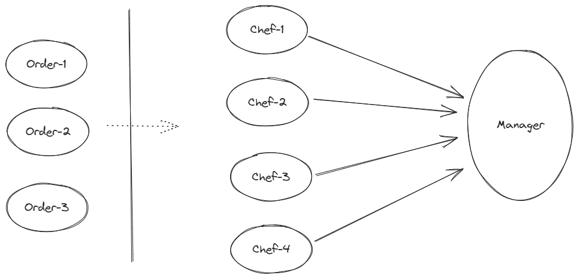
Restaurant Scene
github.com/anjuna/etcd-cats-talk
Quantexa®
7

Slide 8
Distributed System
Need guarantees over work ownership
Scalability
github.com/anjuna/etcd-cats-talk
Quantexa®
8

Slide 9
In Software
Tasks => Orders
Worker nodes => Chefs
ETCD => Kitchen Manager
github.com/anjuna/etcd-cats-talk
Quantexa®
9

Slide 10
ETCD
Strongly consistent key-value store
Based on ‘Raft’ consensus algorithm
“Brain” of Kubernetes
github.com/anjuna/etcd-cats-talk
Quantexa®
10

Slide 11
CompareAndSwap
Atomic instruction to modify some value.
Atomicity guarantees up-to-date info is used
CAS(key, value):=
if (getValue(key) == null)
setValue(value)
return
getValue(key)
github.com/anjuna/etcd-cats-talk
Quantexa®
11

Slide 12
Worker nodes
Worker(taskKey, locationId):=
res = CAS(taskKey, locationId)
if (res == locationId)
doWork()
else
wait()
github.com/anjuna/etcd-cats-talk
Quantexa®
12

Slide 13
First implementation…
Not resilient – worker failure means no progress is made
github.com/anjuna/etcd-cats-talk
Quantexa®
13

Slide 14
Resiliency
Need worker nodes that did not initially win to try to win it afterwards
github.com/anjuna/etcd-cats-talk
Quantexa®
14

Slide 15
Heartbeats/KeepAlives
Temporary key set in ETCD will be deleted after a set time of inactivity
Node that won the race must periodically send a ‘heartbeat’ message to ETCD to keep the value alive
Follower nodes will re-attempt to win race in case the winner expires and the value is deleted
github.com/anjuna/etcd-cats-talk
Quantexa®
15

Slide 16
Worker nodes with heartbeats
Worker(taskKey, locationId):=
res = CAS(taskKey, locationId)
if (res == locationId)
{doWork(), keepAlive(locationId)}
else
Worker(taskKey, locationId)
github.com/anjuna/etcd-cats-talk
Quantexa®
16

Slide 17
Second implementation
Nodes will pick up the work even if task completes successfully
github.com/anjuna/etcd-cats-talk
Quantexa®
17

Slide 18
Wrap up
Built a scalable and resilient Work-Sharing system out of smaller building blocks
Leveraged power of ETCD to provide strong consistency guarantees
Implemented concurrency within a node using Cats-Effect
github.com/anjuna/etcd-cats-talk
Quantexa®
18

Slide 19
Thank you.
Quantexa®

